Slide 1

IBM Watson Studio Visión General
Notes:
This deck provides a brief overview of the “IBM Data Science Experience” (DSX). This is our offering to the Data Scientist persona in our next generation platform called Watson Data Platform. DSX initially moved to “closed beta” in June, 2016 and is now Generally Available (GA) as of November, 2016.
If you have questions or concerns about this deck, please contact:
Shashank BK (shashank@ca.ibm.com) - Worldwide Data Science Competitive and Product Strategy
The Slack channel for DSX is #win-datascientists
The URL to access DSX is datascience.ibm.com

Slide 2
Contents
IBM Watson Data Platform
IBM Watson Studio
Proyectos y comunidad
Proyectos
Integración con GitHub
Community Cards
IBM Valor agregado
IBM Analytics for Apache Spark
Object Storage
Watson Data Platform Connectors
Open Source
RStudio
Shiny Framework para aplicaciones web
Apéndice

Slide 3
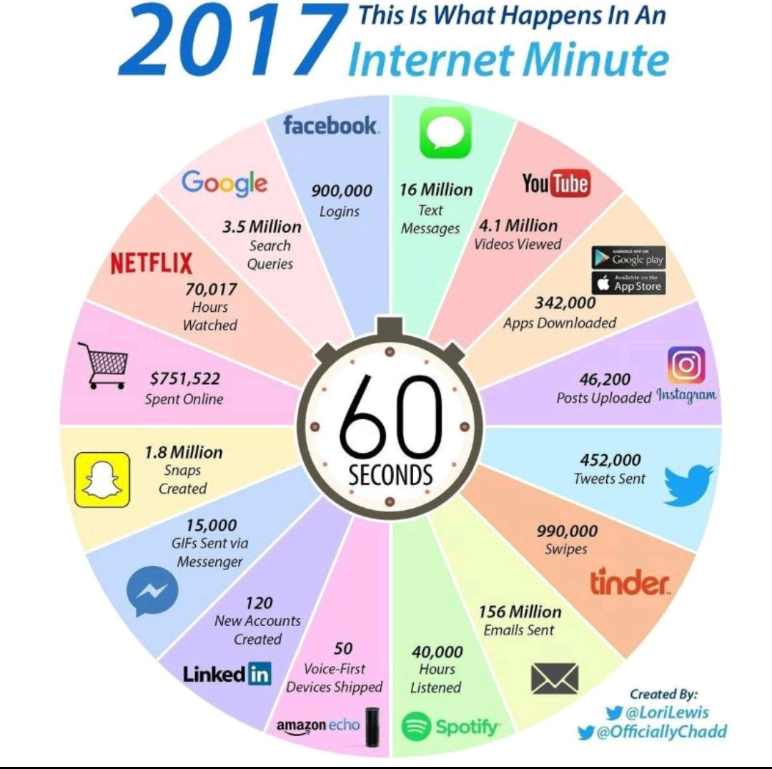

Slide 4
Introduciendo IBM Watson Data Platform
La primera plataforma de datos y analítica para el negocio cognitivo
Plataforma.
Método.
Ecosistema.
http://ibm.co/makedatasimple
Notes:
Para atender esta gran demanda trajimos al mercado IBM Watson Data Plataform.
Esta plataforma es la nueva generación de servicios de datos cloud
Se integra alrededor de todos los tipos de datos, facilita la puesta en producción o despliegue de modelos y provee un ambiente colaborativo.
IBM creó un ecosistema de partners basados en open source por lo que integraciones a la plataforma son muy sencillas.

Slide 5





IBM Watson Data Platform Experimenta nuevas formas de poner los datos a trabajar
Data Engineering
Data Science
Business Analysis
App Development
Experiencias
Tareas específicas, ambiente colaborativo
Servicios de datos y analítica
comprensivo
abierto • inteligente • híbrido
Notes:
This is a high level diagram of the Watson Data Platform. It starts with the collaborative tools for the data professionals: The data engineers, data scientists, application developers and business analysts - We call these “Experiences” as they are not just new, self-service tools. Rather, they include content and a community infrastructure so data professionals can learn from each other and work faster and better in a collaborative environment.
IBM Watson Data Platform also contains individual Data and Analytics Services in the areas of Information integration and Governance, Data Storage, Advanced Analytics and so on … And these can be applied across the entire data and analytics lifecycle. It uses cognitive-assisted capabilities and machine learning to simplify and automate the deployment and management of insights and models that power a cognitive business.
So depending on the short and long term needs, IBM Watson Data Platform is built to provide clients with flexibility and speed of adoption needed to gain meaningful insights and transform their business

Slide 6
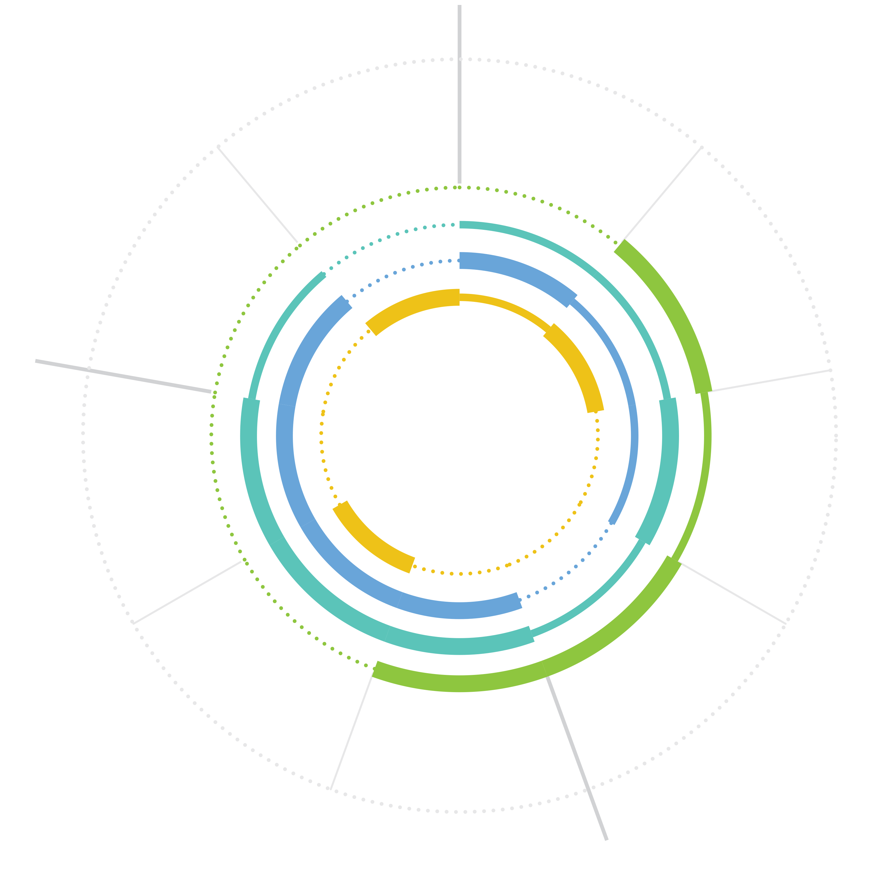
Experiencias a la medida y colaboración de usuarios
Salida
Data Engineer
Entrada
Organiza arquitectura de datos y asegura operabilidad
Entregar y desplegar el modelo
Entender propleba y dominio
Bluemix Data Connect
Data Scientist
Comunicar resultados
Ingerir datos
Se adentra en los datos para obtener “insights” sobre el negocio
Watson Studio
Crear y construer modelo
Explorar y entender datos
Business Analyst
Trabaja con datos para aplicar los “insights” a la estrategia de negocios
Watson Analytics
Transformar: limpiar
Evaluar
App Developer
Transformar: forma
Se conecta a los datos y modelos y escribe Código par acrear aplicaciones
Análisis
Bluemix
Notes:
The “Experiences” are product offerings that consist of a set of services and an interface tailored for each role. In addition to the tailored interface, collaboration really ties the team and the organization together by allowing them to share projects, code and ideas. Imagine a data engineer builds out a new data source and shares that asset with the Data Scientist and the Business Analyst. The Business Analyst immediately builds the reports and dashboards they need. The Data Scientist experiments with the data and ultimately builds a model that passes all the tests and is worth of promoting to new applications. They can immediately share that model with the Application Developer who deploys a new application using the model. Along this journey the team members are keeping each other updated on their status, asking questions and maybe sharing ideas or requirements.
This is where Data and Analytics Development becomes a team sport. No longer does this need to be done in silos. Additionally, because these assets can now be published – other departments can re-use these assets, making the entire organization more agile.
The initial roles we’re targeting are listed above, along with the interface that will be used and the functionality we’re focusing on. The Data Science Experience was announced in June 2016 at Spark Summit and has been receiving rave reviews.

Slide 7
Atributos principales de Watson Studio
IBM Data Science Experience
Community
Open Source
IBM Added Value
Data Refinery
Watson Machine Learning**
Prescriptive Analytics – DOcplexcloud**
Projects and Version Control
Managed Spark Service
Find tutorials and datasets
Connect with Data Scientists
Ask questions
Read articles and papers
Fork and share projects
Code in Scala/Python/R/SQL
Jupyter Notebooks
RStudio IDE and Shiny
Apache Spark
Your favorite libraries
Powered by IBM Watson Data Platform
* Closed beta
** Integrated with DSX, but separate part numbers need to be purchased to use this capability
Notes:
The new offering IBM Data Science Experience brings together everything that a Data Scientist needs today to be more successful. It is based on three concepts:
Community: A Data Scientist needs to be updated with the latest news from the Data Science Community. There are plenty of new Open Source packages, libraries, techniques and tutorials available every day. A good Data Scientist follows the most important sources and shares their opinion and experiments with the community. We are bringing this into the user interface of DSX – so you don’t really have to open up a bunch of different bowser tabs to do your research, you can do it right inside the tool.
Open Source: Un equipo de científicos de datos no se va a estandarizar con una sola tecnología o herramienta. Los científicos de datos necesitan una plataforma abierta e integrada que reuna toda lo que necesitan en un mismo lugar. Por esta razón, DSX Brinda lo mejor del open source con herramientas como Python, Spark, Rstudio y Jupyter.
Value Add: We improve open source by adding some capabilities from IBM. Data Shaping for example takes 80% of the Data Scientist’s time. We are providing tools with visual GUI to help users better perform this task. You are also able to execute Spark jobs on our managed Spark Service in Bluemix from within the DSX.

Slide 8

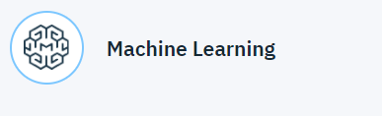

Conceptos claves Watson Studio
Apache Spark es un framework open source de computación en clusters optimizado para procesamiento de datos rápido y a larga escala.
Permite guardar los modelos en un repositorio y luego desplegarlos como un RES API con pocas líneas de código
Permite almacenar grandes cantidades de datos no estructurados de manera sencilla, escalable y económica.

Slide 9

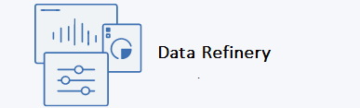
Conceptos claves – Watson Studio
Un catálogo de datos integrado que optimiza el gobierno sobre los datos
App auto servicio de preprocesamiento de datos para data scientists, data engineers y business analysts.

Slide 10


Slide 11
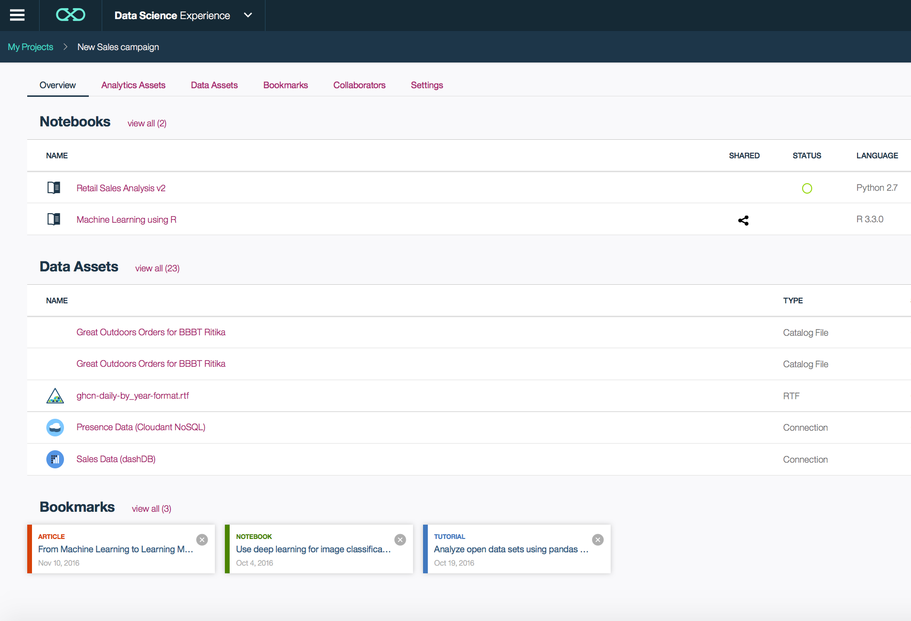
Colabora usando proyectos
Notes:
Projects are a core component of our Watson Data Platform. Projects make collaboration easier – they are a collaborative entity with data services, connections, object storage, notebooks and more. Once you create a new project within Data Science Experience, you are presented with an interface like the one shown in the slide, it is a project management framework where you can view/create/add/modify/remove various assets. A framework like this can play a huge role in bringing down siloes across the various data personas and promote collaboration.

Slide 12
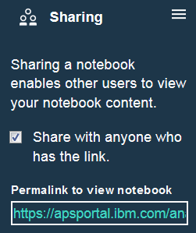
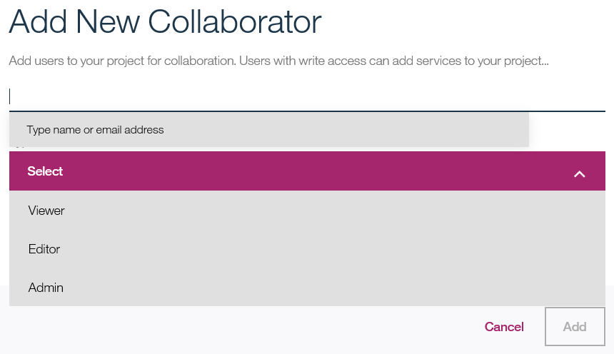
Funciones para compartir y reutilizar activos del proyecto para aumentar la productividad del equipo.
Notes:
Projects allow different users and personas to share sets of assets while building their data products. For example, you can create a Project, add in your assets such as a notebook and files in object storage, and then add collaborators such as your co-workers. Your collaborators can have different permission rights too. Maybe you’ll make some of your collaborators Editors of the Project, others Viewers, and maybe a couple of people will have Admin rights.
You can also easily share notebooks with others by posting its permalink in view-only mode on Twitter, GitHub, Slack, and so on.

Slide 13
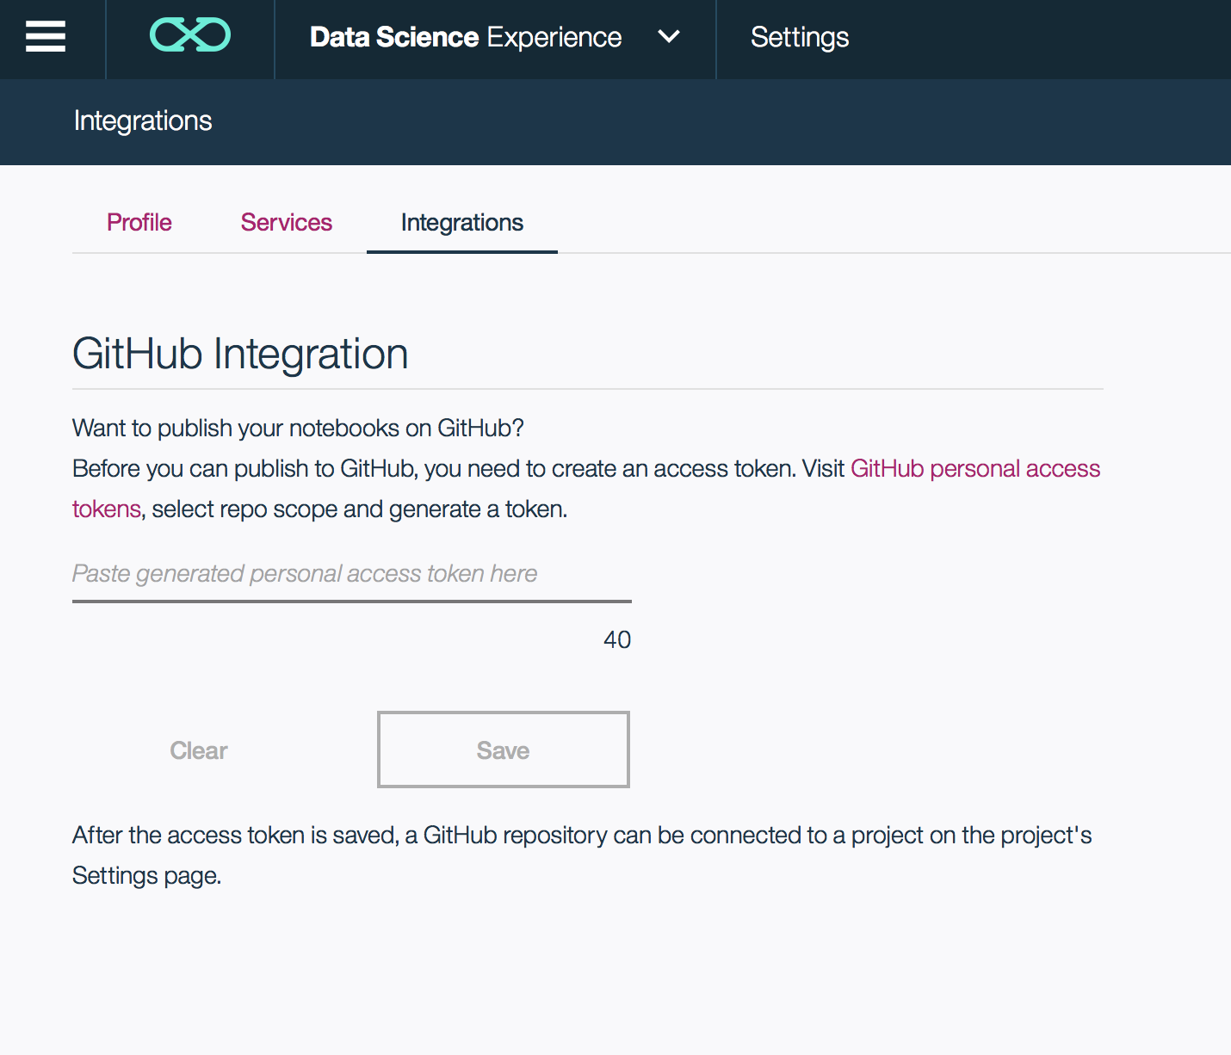
Integración con GitHub
Notes:
We recently announced the integration of GitHub with the IBM Data Science Experience to enhance the collaboration between data scientists. Now you can combine code, data and visualizations in real-time with your colleagues.
The various ways you can use GitHub with the Data Science Experience are listed below:
1- Connect your GitHub account with DSX
2- Connect a GitHub repo to a DSX Project
3- Publish your notebook to GitHub
4- Import notebooks from GitHub
Not too sure what Git is ? No problem, check out the appendix for further information and also take this simple 15 minute online course to get familiar with it: https://try.github.io/levels/1/challenges/1
For a step by step approach (with screenshots) to connect your DSX and GitHub please look here: http://datascience.ibm.com/blog/github-integration-available-2/
For customers and clients who want version control but don’t feel too comfortable with Git we still have simplified Version Control available for you. This is based on Jupyter checkpoints and it is limited to 10 versions of each notebook.

Slide 14
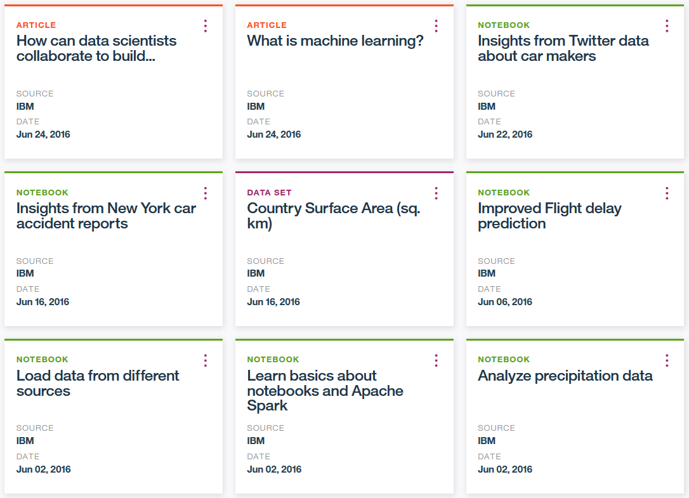
Community Cards: Información en context para los usuarios
Notes:
In-context learning and community are key components of Data Science Experience. In fact, once you log into the tool the first thing you will come across are these boxes – we call them community cards.
We have four types of cards – data sets, notebooks, tutorials, and articles. These are designed to make it easier for you to learn about data science and experiment with its various tools and techniques on-the-fly as you work in DSX. We have hundreds of community cards today and we continue to add many more from the data science community.

Slide 15
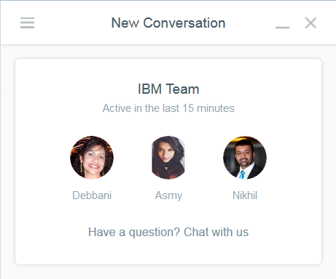

Chatea en vivo con Intercom para tener soporte del equipo de IBM y para brindar retroalimentación de cómo mejorar DSX
Notes:
On the bottom right-hand corner you will see a live chat feature via Intercom. Here you can chat with IBMers who are familiar with DSX. Many of these IBMers are DSX developers and offering managers.
Through this live chat feature you can also continue conversations the next time you log into DSX. We use the feedback captured through live chat and the offering’s instrumentation to guide our decisions in designing and developing Data Science Experience. We actually perform this analysis using DSX itself.

Slide 16
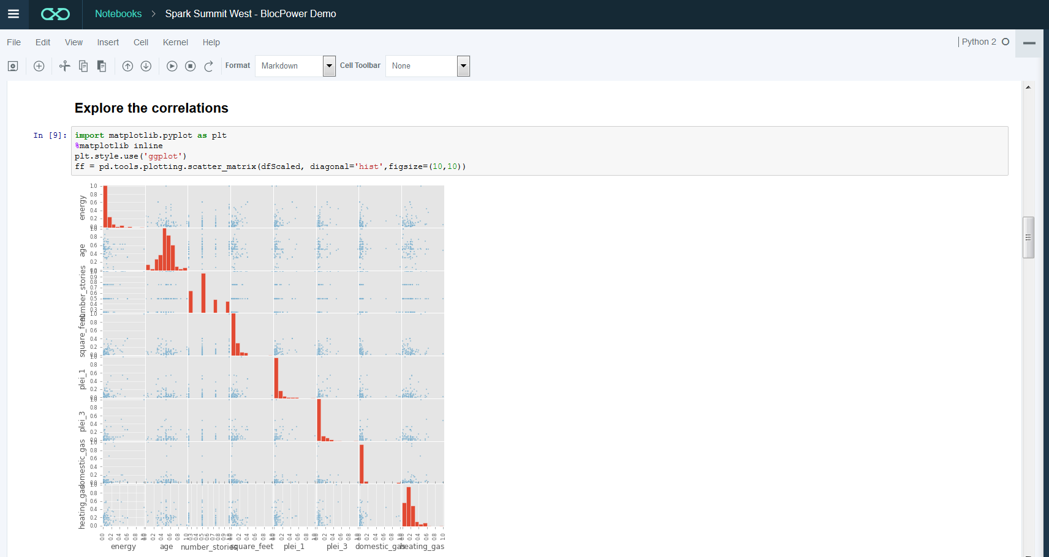
Jupyter Notebooks Integrados para un desarrollo interactivo y colaborativo. Ejecición sin problemas con Spark
Notes:
A major IBM value-add in DSX is our Jupyter Notebook integration (Jupyter was derived from the iPython project – there are over 200,000 iPython notebooks on GitHub). These notebooks can be associated with a Spark service instance for scalable execution of Spark code on a Spark cluster on Bluemix. We currently support R, Python and Scala Spark APIs in our notebooks. They can be created from Blank, File and URL.
For those of you who are not familiar with Notebooks, they allow teams to combine documentation and code, execute programs line by line, and merge the results into compelling visualizations … all within the same framework! It is a unified environment for collaboration – and entirely accessible by non-technical professionals over a Web browser.

Slide 17






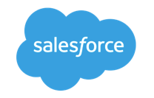













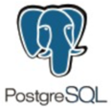






Desde un Notebook puedes usar el servicio de Spark asministrado por IBM para mezclar multiples tipos de datos, fuentes y cargas
Execute SQL Statements
Streaming Analytics via Micro-batch
M.L. and Statistical Algorithms
Distributed Graph Processing Framework
Spark SQL
Spark Streaming
MLlib Machine Learning
Graph
General compute engine
Basic I/O functions
Task dispatching
Scheduling
Spark Core
Data Sources
IBM Cloud | Public Cloud | Cloud Apps | On-Premises
BigInsights (HDFS)
Cloudant (DBaaS)
dashDB (Analytics)
SQDB (Managed DB2)
Swift (Object Storage)
Notes:
From a Notebook in DSX you can use IBM Analytics for Apache Spark to blend multiple data types, sources, and workloads. IBM Analytics for Apache Spark is a fully managed service on Bluemix.
For example, Spark SQL is available to address the needs of so many of our current customers and partners that want to be able to work with their traditional relational databases, using a performant and powerful technology like Spark, but be able to do so without needing to know how to code MapReduce jobs in Java. Using SparkSQL, a developer can apply their knowledge of SQL statements directly in Spark code, and tap into a large number of relational databases Spark supports in order to apply in-memory analytics over bread and butter relational SQL databases.
And beyond SparkSQL, we can attack new problems with Spark’s machine learning library, Spark Streaming, and Graph. The power of Spark is the ease of developing analytics applications using a unified framework across all of these libraries. For more details on this please check the appendix of this deck.
Towards the bottom of the slide, I've highlighted the connection opportunities we have with Spark today – and keep in mind that this list is not exhaustive and is ever-expanding. Focus your attention particularly on the integrations with the IBM portfolio (on the left) that we support currently. Of course, the logical fits are there: connect Spark to BigInsights On-Premises or BigInsights on Cloud to land your data in HDFS and access the suite of enterprise-grade technologies we support atop BigInsights. But consider as well the dramatic innovations in areas like our button-push connectivity to databases like NoSQL database-as-a-service Cloudant. Application developers, Web services, and mobile apps now have direct-line access to an in-memory analytic processing framework that can even handle near-real time ingest of data from Internet of Things data streams and messaging hubs.
The best practice for the Spark service is using object storage (Swift) as the data store.

Slide 18
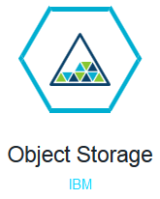
The Spark Service uses Bluemix Object Storage as its preferred data store for building performant applications
Object storage provides inexpensive, scalable and self-healing retention of massive amounts of unstructured data
Every object exists at the same level in a flat address space
Bluemix Object Storage has a drag-and-drop upload and Swift API for programmatic access
Notes:
Object storage, also called object-based storage, is a generic term that describes an approach to addressing and manipulating discrete units of storage called objects.
Like files, objects contain data -- but unlike files, objects are not organized in a hierarchy. Every object exists at the same level in a flat address space called a storage pool and one object cannot be placed inside another object. Each object is assigned a unique identifier which allows a server or end user to retrieve the object without needing to know the physical location of the data.
Object storage is often compared to valet parking at an upscale restaurant. When a customer uses valet parking, he exchanges his car keys for a receipt. The customer does not know where his car will be parked or how many times an attendant might move the car while the customer is dining. In this analogy, a storage object's unique identifier represents the customer's receipt.
Object storage systems allow relatively inexpensive, scalable and self-healing retention of massive amounts of unstructured data. Object storage is used for diverse purposes such as storing photos on Facebook, songs on Spotify, or files in online collaboration services, such as Dropbox.
Object Storage provides an unstructured cloud data store to build and deliver cloud applications and services with lowered cost, reliability, and speed to market. Bluemix developers and users can access and store unstructured data content and can interactively compose and connect to applications and services. The Object Storage service also provides programmatic access via API, SDKs and a consumable UI for object management.
The free DSX account comes with 5GB of object storage.More details about Object Store are in the Appendix of this presentation.

Slide 19
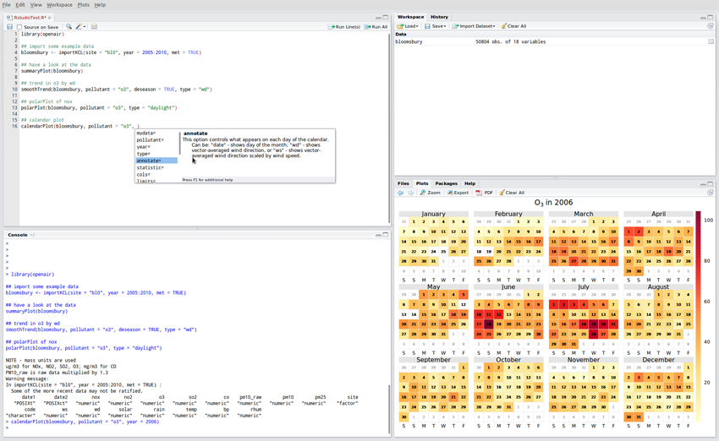
DSX has RStudio built into the experience thanks to our strategic partnership
Notes:
In June of 2016 we announced a strategic partnership with RStudio to further demonstrate our commitment to the R language and building a superior experience for Data Scientists within DSX.
RStudio is a provider of open-source and enterprise-ready commercial tools for the R community. Founded in 2008, it is headquartered in Boston, MA. Inspired by the innovations of R users in science, education, and industry, RStudio develops free and open tools for R and enterprise-ready professional products for teams to scale and share work.
A partnership with RStudio brings together IBM’s Big Data & Analytics technology depth and services breadth with RStudio’s platform and expertise on R. We are mutually aligned on the goal to make R a first-class citizen in Spark.
IBM and RStudio will collaborate to enable R packages to integrate with Apache Spark. R is a popular statistical programming language that offers a rich environment for statistical analysis and machine learning. The runtime for R is single-threaded, and by ensuring R code and packages work seamlessly with Spark, R users can leverage Spark’s distributed computational engine to run large-scale data analysis from R.
IBM will integrate RStudio’s open source offerings (RStudio Server and Shiny Server) in the Data Science Experience offering. RStudio Server is an Integrated Development Environment (IDE) for R. It includes a console, syntax-highlighting editor that supports direct code execution, as well as tools for plotting, history, debugging and workspace management. Shiny Server is an open source web application server that combines the power of R with the interactivity of the modern web providing the deployment needed for Shiny applications. Additionally, In the Data Science Experience offering, IBM will expose tutorials and news from RStudio blogs.
You can easily install the more than 5000 R packages on CRAN in DSX RStudio.

Slide 20
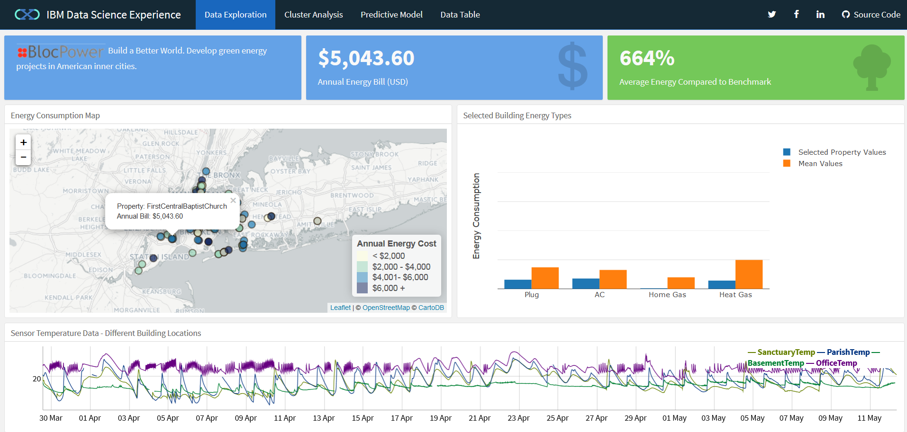
With RStudio you can create Shiny web applications to make your analysis accessible to the business
Notes:
You can also make your R analysis accessible to non-programmers via Shiny. This is an excellent option for deploying your data science analysis to your business users.
Shiny is a web application framework for R. It enables you to turn your R analysis into interactive web applications. No HTML, CSS, or JavaScript knowledge required.
To learn more about Shiny, check out their website and tutorials: http://shiny.rstudio.com/

Slide 21

Modelling Energy Usage in NYC – BlocPower
"BlocPower operation is diverse from outreach and targeting, origination of investment-grade clean energy projects to financing projects through our crowdfunding marketplace. Data is the underlying tool of our operation and IBM's Data Science Experience will facilitate a closer integration across it and help our business scale up faster. “
— Tooraji Arvajeh, Chief Engineering Officer, BlocPower
Blog Link: http://ibm.co/29KLbvu
Notes:
On June 6 we introduced the IBM Data Science Experience to the world at the Spark Maker Event that took place in Galvanize. We demonstrated the Experience with a real use case developed in partnership with BlocPower.
BlocPower is a startup based in New York City. Its technology and finance platform develops clean energy projects in American inner cities. IBM Data Science Experience helped BlocPower perform a comprehensive energy audit of each property to determine the correct mix of high-efficiency technology to reduce each customer's energy consumption. Tooraj Arvajeh, Chief Engineering Officer at BlocPower, explained how IBM Data Science Experience made this process simpler. As part of the collaboration, Tooraji provided the following quote:
"BlocPower operation is diverse from outreach and targeting, origination of investment-grade clean energy projects to financing projects through our crowdfunding marketplace. Data is the underlying tool of our operation and IBM's Data Science Experience will facilitate a closer integration across it and help our business scale up faster. "
The goals of the demo where to show the following:
Easily import data into a notebook from object storage to quickly start analyzing data and creating predictive models.
Model energy usage of buildings in kWh.
Identify buildings that consume energy inefficiently.
Create a project and collaborate with other data scientists.
Create an easy-to-use application to make the outcome of the models consumable by any user.
Blog link: http://ibm.co/29KLbvu

Slide 22
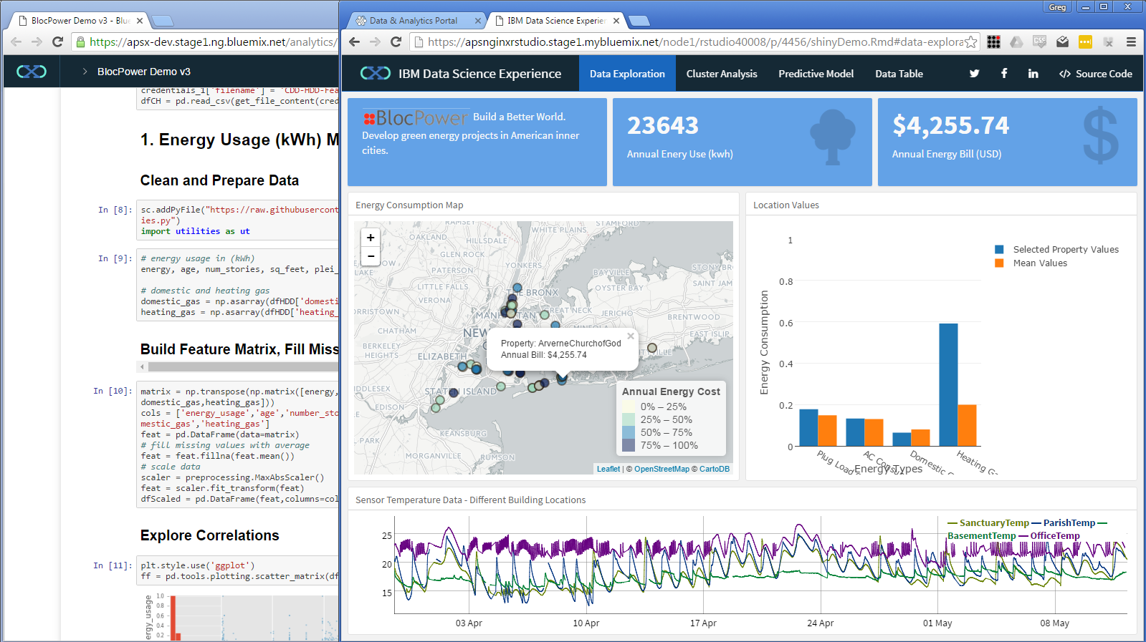
Use Shiny apps to share your analysis with business users
Notes:
ere is a screenshot of the BlocPower demo that we showed on main stage during the DSX signature moment. In the background you see a fully integrated Jupyter notebook which supports R, Python, and Scala. Data Scientists typically use these notebooks to develop code for analysis and visualization. In this demo we also utilize the DSX RStudio integration. From RStudio we develop and launch a Shiny app – a web app providing a dashboard of data visualizations and drilldown. Shiny is a framework for developing web applications with R. We also leveraged the Flex Dashboards package from RStudio.
In this case, we are analyzing building energy usage data in NYC. You can see we’ve launched an additional window to start out data exploration in Shiny. We are analyzing sensor temperature data on that bottom, relative to different building locations.

Slide 23
IBM machine learning

Slide 24
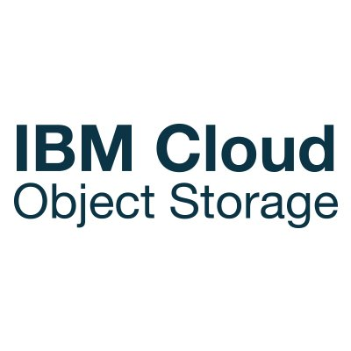
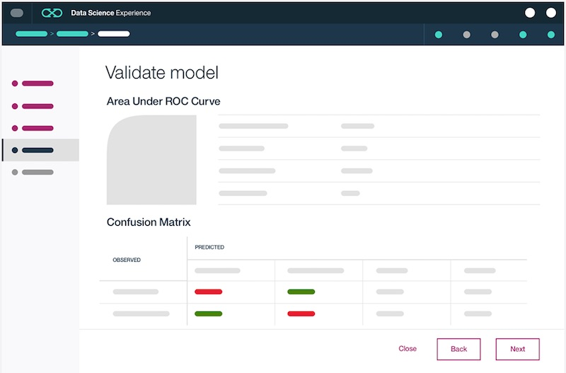

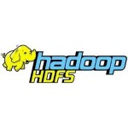
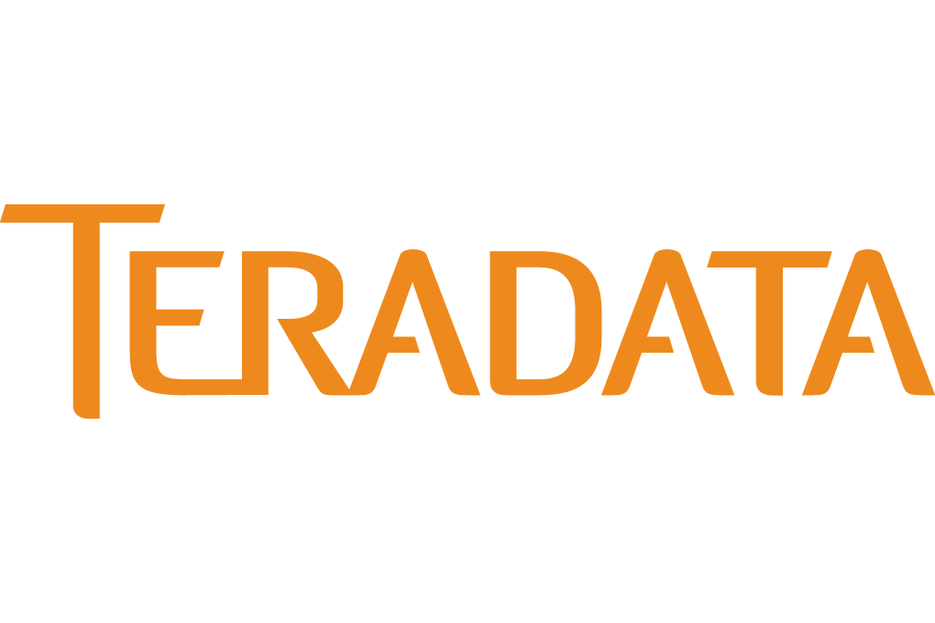
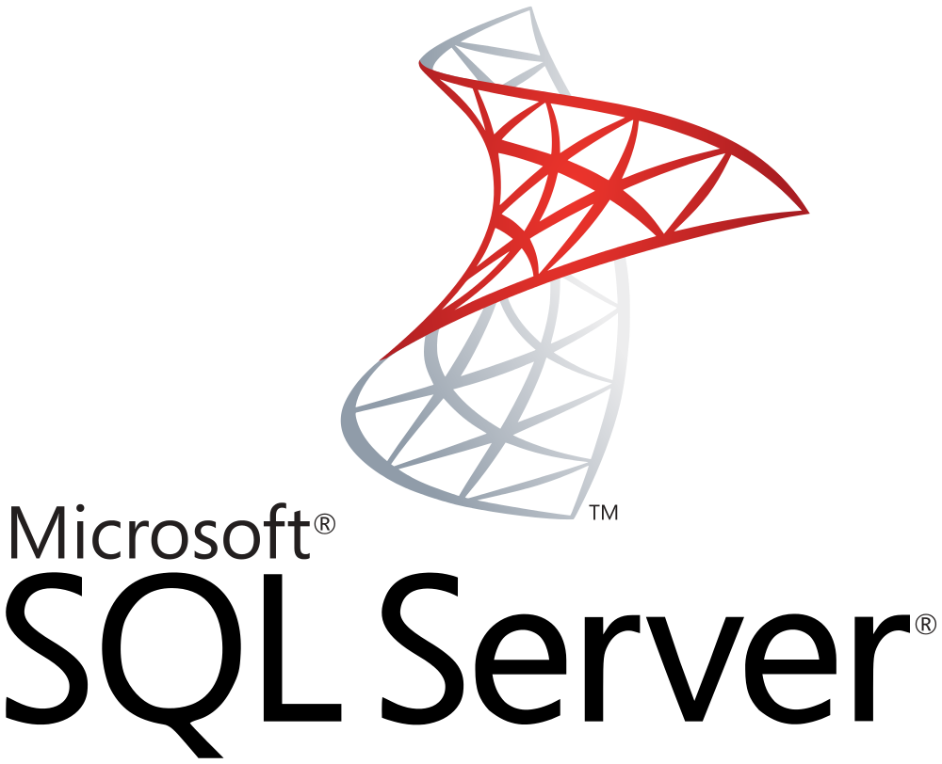

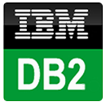

Operationalize insights with IBM Machine Learning
IBM Machine Learning
Web Service
IMS
Data Access:
Easily connect to Behind-the-Firewall and Public Cloud Data
Catalogued and Governed Controls through Watson Data Platform
Creating Models:
Single UI and API for creating ML Models on various Runtimes
Auto-Modelling and Hyperparameter Optimization
Web Service:
Real-time, Streaming, and Batch Deployment
Continuous Monitoring and Feedback Loop
Intelligent Apps:
Integrate ML models with apps, websites, etc.
Continuously Improve and Adapt with Self-Learning
Notes:
Very few companies have systems in place today that can score, act, monitor, and ingest feedback. That’s where IBM Machine Learning (IBM ML) comes in. It was designed to support a continuous cycle of learning (i.e., “self-learning”). IBM ML solves a major pain point for customers by enabling them to build self-learning systems that can score, act, monitor, and ingest feedback to drive better business outcomes.
IBM Machine Learning enables you to create end-to-end pipelines with your data assets – it is the fabric that supports you in operationalizing insights from machine learning. A pipeline includes everything from connecting to your data sources, preparing your data, modelling, model evaluation, to model deployment and management.
Let’s start with the left-hand side of this chart. You can see that IBM ML can leverage the 30+ data connectors in Data Science Experience (DSX) to connect to your private cloud (on-premises) and public cloud data assets (e.g., Microsoft Azure, Amazon S3, Cloudant, etc.). These data assets can be catalogued and governed through additional Watson Data platform services. Within DSX there is both a Wizard UI and API for creating machine learning models on various runtimes (e.g. SparkML, SPSS, etc.). And to further assist Data Scientists during the modelling process, IBM ML has auto-modelling capabilities such as hyper parameter optimization.
Once the Data Scientist has built a model using IBM ML, the model can be deployed with a single click as a web service. IBM ML supports 3 forms of deployment – real-time, streaming, and batch deployment. To submit scoring requests against a deployed Watson Machine Learning model, simply ping the scoring endpoint with your authorization token. This enables IBM ML models to be integrated into websites, mobile applications, operational systems, dashboards, etc. to improve business outcomes across a variety of use cases (e.g. personalized recommendation as a mobile app, transaction risk scoring, call center content generation, etc.). The end application could be written in Java, JavaScript, Ruby, etc. or perhaps a mobile app on Android or iOS.
And once your models have been deployed, the DSX user interface (UI) provides continuous monitoring and feedback of your web service. Keep in mind that you aren’t limited to deploying your models into simple apps – you can also use the standard APIs included with IBM Machine Learning to integrate with complex operational systems. IBM ML can be the backbone of your customer’s “hard deploy” strategy for machine learning across their company (i.e., having machine learning dynamically baked into their systems).
Given the continuous monitoring and feedback loop capabilities of IBM ML, you may hear the term “self-learning” come up during customer conversations. When a customer mentions the need for a “self-learning” capability, they may be referring to:
The traditional way of building and retraining models (a Data Scientist follows all steps in building a model, including data evaluation, data preparation, model building, and model evaluation)
Auto-modeling, which is a technique where the Data Scientist does not “build a model” themselves through hand-tuning. Instead, the model is automatically built using an auto-modeling algorithm.
Automatic retraining of models. There are two main forms of “automatic retraining”:
If a model’s performance dips below a given threshold, then a model retraining process automatically kicks off
Using a streaming implementation of a machine learning algorithm (e.g. streaming K-means). These algorithm implementations automatically retrain as they receive new data points (e.g. exponential decay balancing importance of new vs. old data).

Slide 25





IBM Machine Learning – Functionality for All!
IBM Machine Learning (on Bluemix)
Data Science Experience with IBM ML
IBM Machine Learning for z/OS (with DSX)
App Developer
Data Scientist
Data Scientist
Notes:
IBM Machine Learning will be initially exposed through 3 different sets of packaging – on Bluemix, inside Data Science Experience Public Cloud, and a private cloud (on-premises) deployment for z/OS (which will leverage DSX Private Cloud in 1H 2017).
These different sets of packaging/exposure are intended for different audiences. IBM Machine Learning on Bluemix is designed for the Application Developer persona. IBM Machine Learning in Data Science Experience Public Cloud targets the Data Scientist persona. And IBM Machine Learning for z/OS targets mainframe workloads using Apache Spark (i.e., Spark on z/OS).
IBM ML is already available on Bluemix. The first phase of IBM ML was a rebranding of the Bluemix “SPSS Predictive Analytics” service to “IBM Machine Learning”. We will continue to expand this offering beyond the SPSS runtime to include addition runtimes and features.
For IBM ML inside Data Science Experience, two methods for accessing IBM ML will exist – (a) wizard GUI to create models, and (b) an API to deploy and manage models from notebooks. Users who prefer coding will likely use the notebooks with API approach, whereas users who’d like to build models without writing any code will likely prefer the wizard approach.
IBM ML for z/OS is an private cloud (on-premises) deployment of IBM ML to run on Spark z/OS. It will initially be an API-based approach through Jupyter notebooks. In the future IBM ML z/OS will integrate with DSX Private Cloud as the main toolset (often referred to as an Integrated Development Environment … or IDE for short) for IBM ML z/OS.

Slide 26
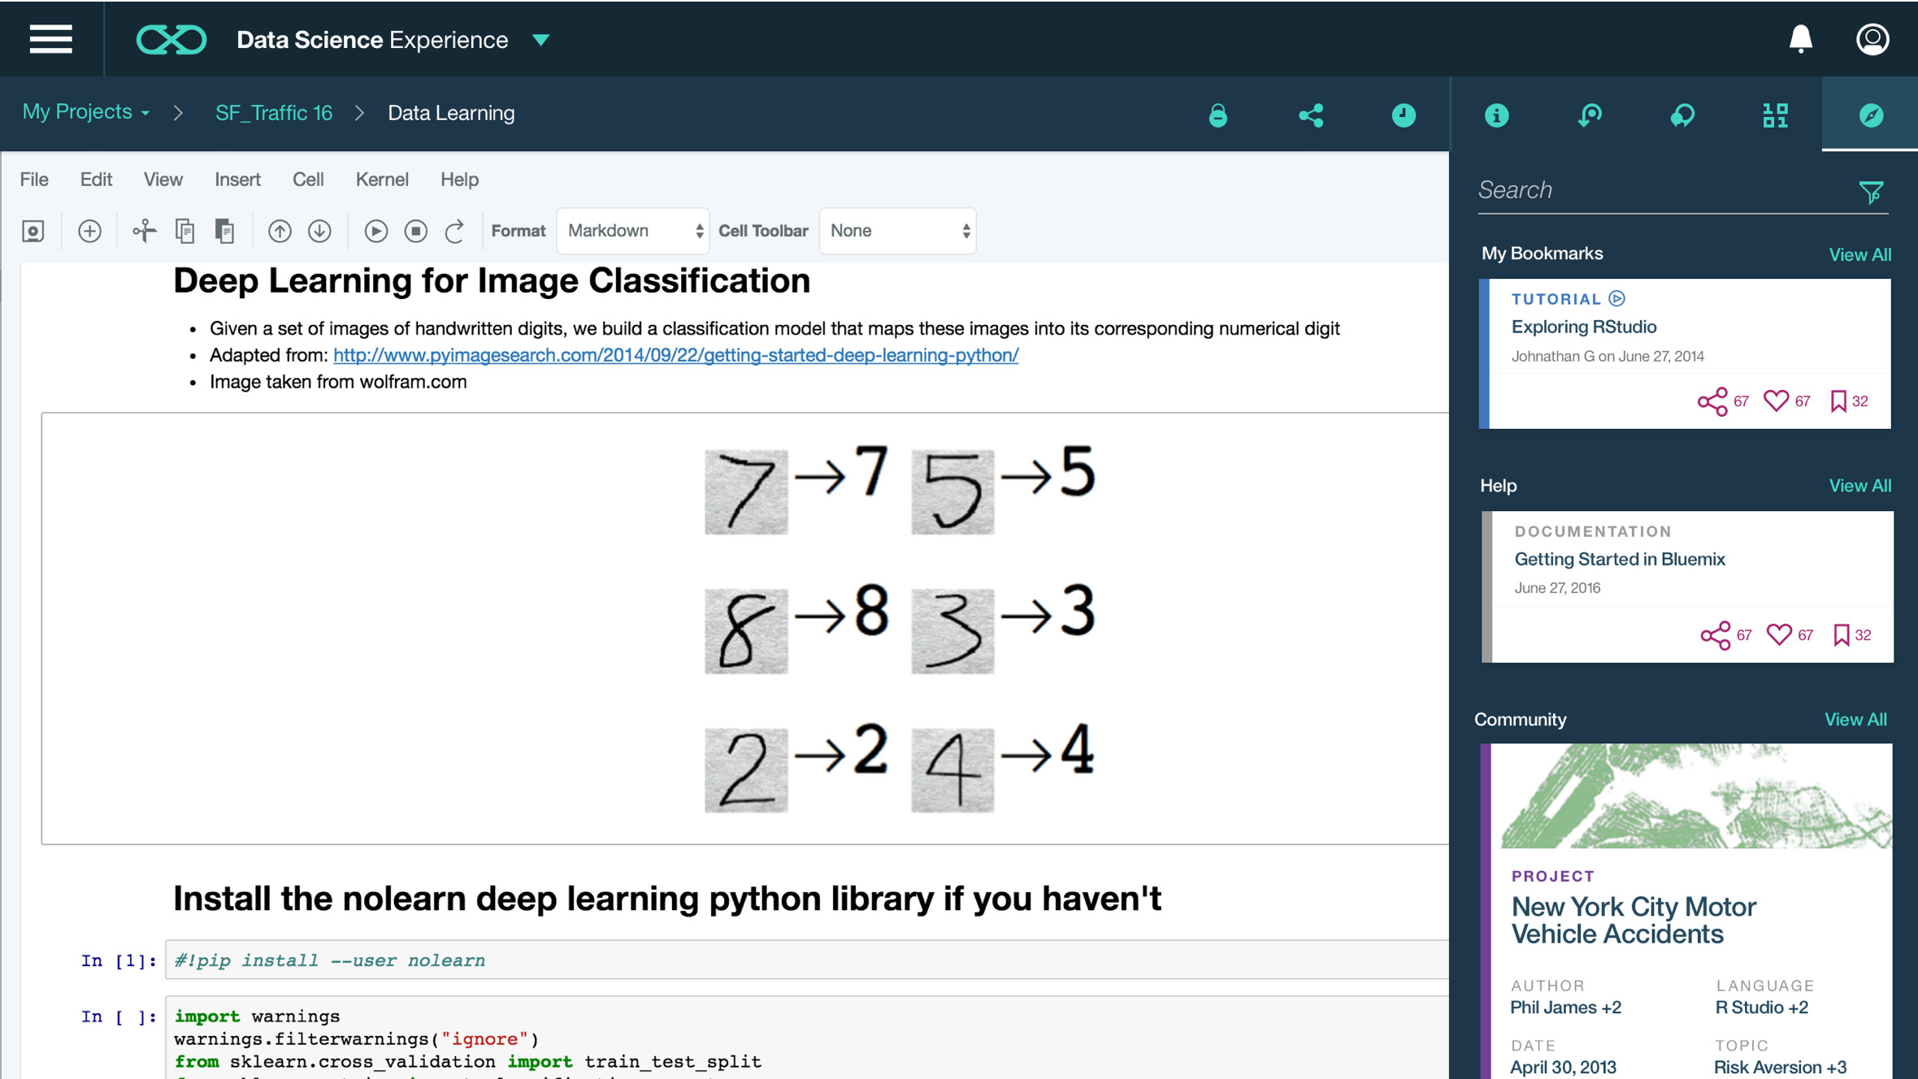
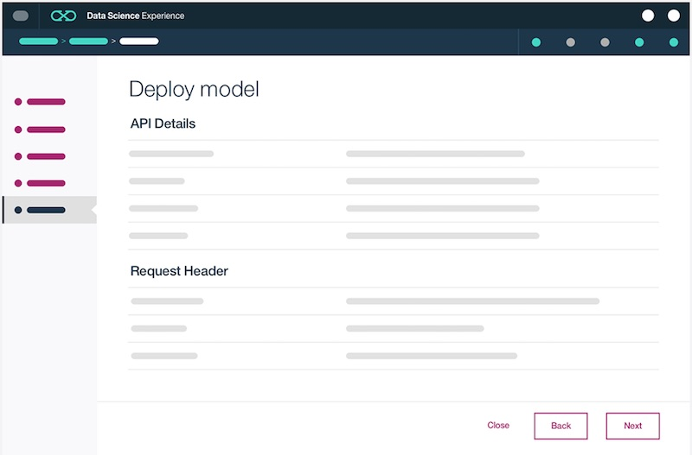
IBM Machine Learning in Data Science Experience
IBM Machine Learning is provisioned by default in Data Science Experience
Enables Data Scientists to deploy machine learning models as web services
Single UI for creating, collaborating, deploying, monitoring, and feedback
Accessible via API, Wizard GUI, and Canvas
API for Jupyter Notebooks
Wizard GUI
Notes:
Now let’s take a look at IBM ML in Data Science Experience.
IBM Machine Learning is provisioned by default in Data Science Experience. It is our deployment fabric that enables Data Scientists to take their models from the lab to production. DSX provides a single UI for creating models, collaborating, deploying, monitoring, and integrating feedback. With a single click, Data Scientists can deploy their machine learning models as web services.
IBM ML is accessible in Data Science Experience via APIs (by coding in Notebooks), Wizard GUI (i.e., called “pipelines” in Projects), and the DSX Canvas (which is a GUI-based approach inspired by SPSS Modeler).
Note: At IBM ML GA in DSX (during 1H 2017) we expect to have both the APIs and Wizard GUI available. The DSX Canvas deployment via IBM ML will GA after the APIs and Wizard.
Also note that DSX Private Cloud will become the standard IDE for IBM ML for z/OS. This is expected to be delivered in 1H 2017.

Slide 27
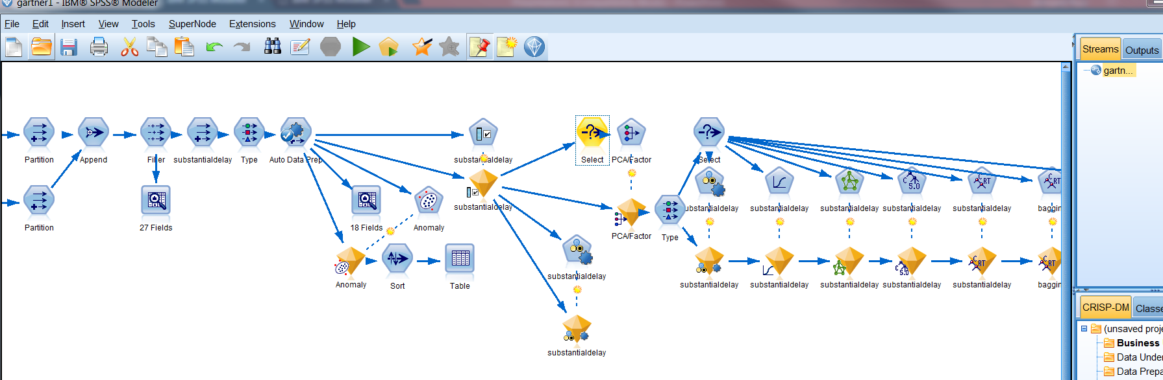
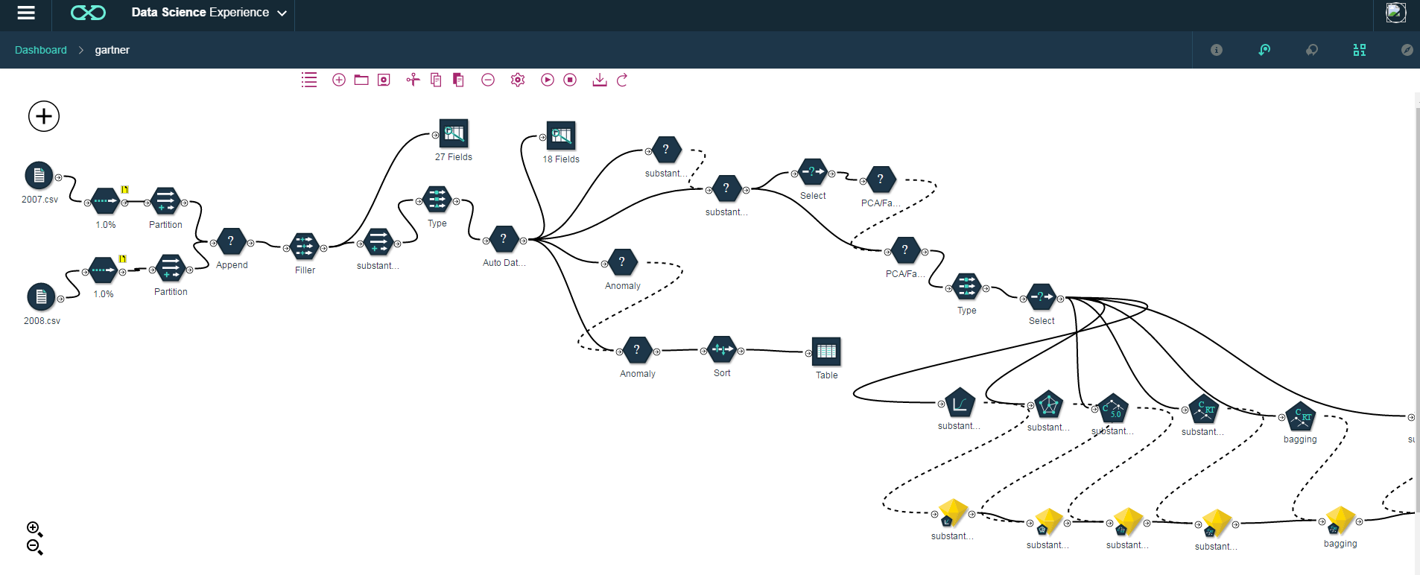
The DSX Canvas is compatible with existing SPSS Modeler Streams and can be deployed via IBM Machine Learning
DSX Canvas has compatibility with legacy SPSS Modeler streams
Multiple execution runtimes: SPSS Modeler, SparkML (coming soon)
Support for R/Python/SQL code in the pipeline
One-click pipeline deployment from DSX Canvas (left) via IBM Machine Learning
DSX Canvas and Canvas One-Click Deployment via IBM ML are Roadmap Items
IBM Internal and Business Partners Only
Notes:
So how is SPSS connected with Data Science Experience and IBM Machine Learning? Well, SPSS is a very healthy business with a huge user base. However, our customers are also looking forward to seeing new features and wondering how to manage a world where SPSS Modeler and open source co-exist as first class citizens. At a lot of accounts that used to be known as “SPSS shops”, we are seeing customers experimenting with new open source technologies and tooling. We need to embrace this and continue to deliver tooling that meets the needs of our customers.
So we are listening to our customers needs and changes in the marketplace – first, we are bringing SPSS Modeler into Data Science Experience – DSX will be the home of the SPSS Modeler cloud client.
Here you have two screenshots on how a user can create a SPSS Modeler stream on their desktop and then import that stream into Data Science Experience to run in what we are calling the “Canvas”. We are going to have compatibility with legacy SPSS streams by developing this SPSS cloud client in DSX. We will support multiple execution engines. One of them is going to be the SPSS runtime to support these legacy streams. And we are also moving into supporting Spark ML pipelines, which will be coming soon (1H 2017). And then we will support R, Python, SQL in code in the same pipeline.
On the deployment side, the Canvas will have options to deploy those pipelines into production in one-click via IBM Machine Learning.
For further details, check out our blog post on “Better Together: SPSS and Data Science Experience“: http://datascience.ibm.com/blog/spss-in-dsx/

Slide 28
appendix

Slide 29
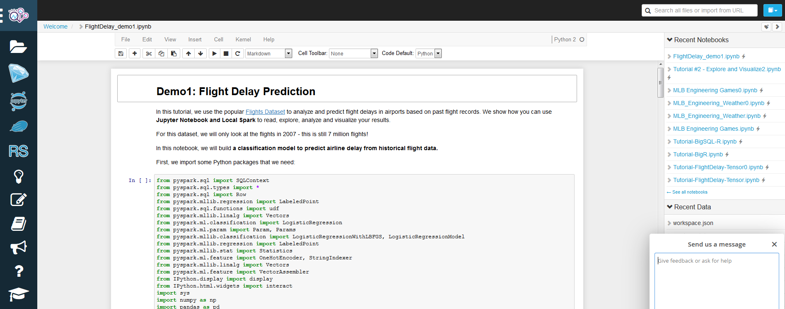
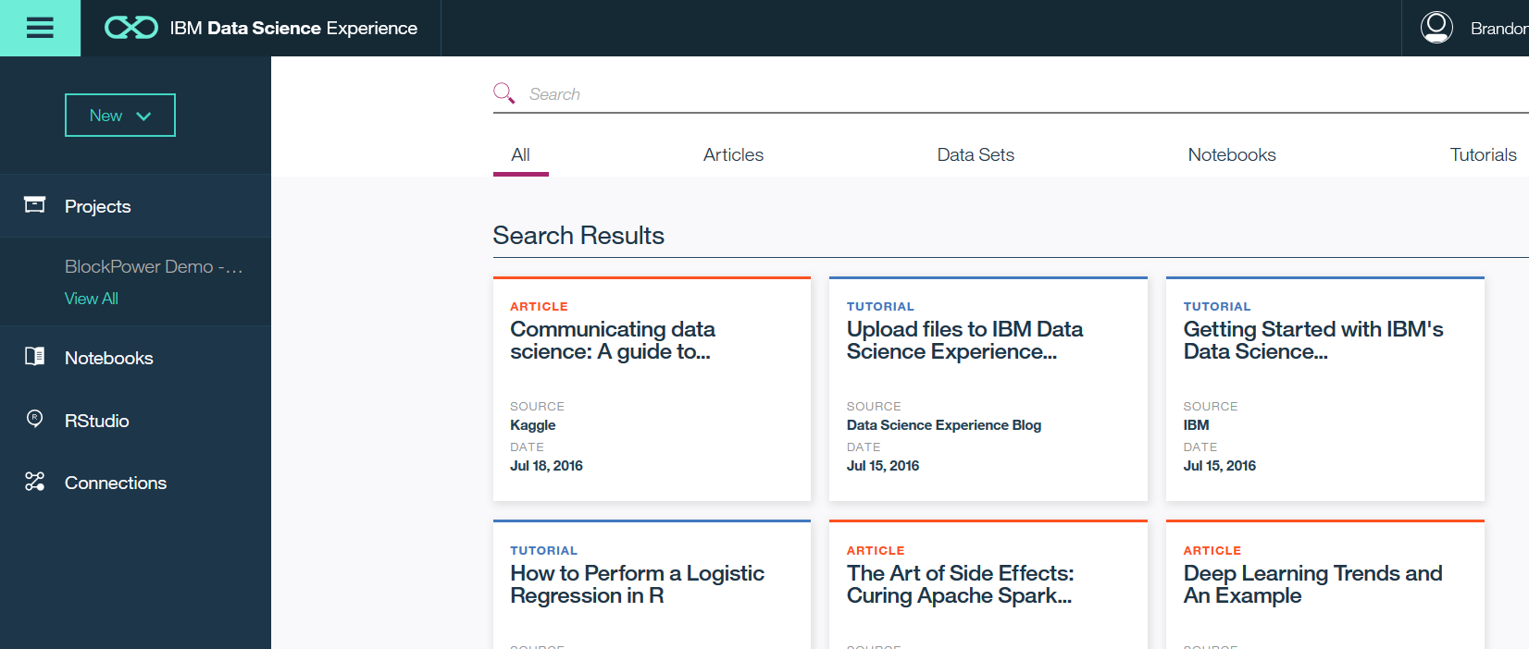
Data Scientist Workbench vs Data Science Experience
Notes:
In short - Data Scientist Workbench validated market demand. Data Science Experience (DSX) is our commercial offering.
Data Scientist Workbench is an incubation project to help us get product and market fit. As with any incubation project the goal is to pursue various technologies and different methods of delivering these technologies to determine what the "paid" offerings should pursue. DSWB is going to continue to push the envelope and explore the needs of the market using DSWB. Data Science Experience may or may not use those findings and will have to take decisions on what capabilities to productize. In DSWB we are adding a lot of new capabilities and we will continue to do so. Again, these are explorations that DSX can learn from but they in no way signal adoption by DSX.
DSWB is what we call a virtual lab environment for the Big Data University. Right now a significant number of BDU courses use DSWB to allow people to do hands on labs. We intend to make all courses use DSWB. As such, it has very unique needs that can't be addressed by DSX or any single IBM product. In BDU we teach technologies that are not yet present in our products, we teach them in geographies where IBM cloud services don't have suitable delivery mechanism (e.g. China, sub-Saharan Africa etc.) and we provide Private BDU Portals to our key accounts that require that all education be done with their own data on their own systems behind the firewall.

Slide 30
Select Libraries to Meet Use-Case Challenges
Unified data access: Query structured data sets with SQL or DataFrame APIs
Fast, familiar query language across all of your enterprise data
Use BI tools to connect and query via JDBC or ODBC drivers
Spark SQL
Spark Streaming
MLlib Machine Learning
GraphX Graphing
+
Spark Core
Notes:
Spark SQL is one component of the Spark Core framework that primarily focuses on delivering a standardized access pattern to Spark data using SQL queries. For DBAs and developers with background in relational-style databases and data structures, Spark SQL allows a SQL-style query approach to data stored in Spark DataFrame APIs. It is also utilized for querying against data stored in JSON documents within Cloudant (a NoSQL database as a service), using the cloudant-spark drivers that map Spark SQL atop Cloudant index semantics.

Slide 31
Select Libraries to Meet Use-Case Challenges
Micro-batch event processing for near-real time analytics
e.g. Internet of Things (IoT) devices, Twitter feeds, Kafka (event hub), etc.
Spark’s engine drives some action or outputs data in batches to various data stores
Spark Streaming
Spark SQL
MLlib Machine Learning
GraphX Graphing
+
Spark Core
Notes:
Spark Streaming, another essential component of the Spark Core libraries, enables micro-batching and near-real time event processing. This library is particularly useful when dealing with Internet of Things (IoT) devices, rapid throughput systems like social media feeds (Twitter), or event-listener technologies such as Apache Kafka or RabbitMQ.

Slide 32
Select Libraries to Meet Use-Case Challenges
Predictive and prescriptive analytics
Machine learning algorithms for:
Clustering
Classification
Regression
etc.
Smart application design from pre-built, out-of-the-box statistical and algorithmic models
MLlib Machine Learning
Spark SQL
Spark Streaming
GraphX Graphing
+
Spark Core
Notes:
MLLib, or Spark’s Machine Learning library, is another key component of the Spark Core framework. It enables developers, Data Scientists, and statisticians to apply advanced machine learning and predictive modeling techniques within their Spark code. Complex modeling and analytical techniques like clustering, classification, regression, support vector machines, and so on are templated and coded as a part of the MLLib library. This allows these audiences to get to work immediately on these complex theorems and models, without the hassle and complexity of implementing these algorithms in Spark code ahead of time.

Slide 33
Select Libraries to Meet Use-Case Challenges
Represent and analyze systems represented by graph nodes
Trace interconnections between graph nodes
Applicable to use cases in transportation, telecommunications, road networks, modeling personal relationships, social media, etc.
GraphX Graphing
Spark SQL
Spark Streaming
MLlib Machine Learning
+
Spark Core
Notes:
Finally, the GraphX library provides essential graphing tools as part of the Spark Core framework. Similarly to the MLLib library, the GraphX library handles the complexity of modeling graphing databases and structures ahead of time; therefore, a user of the GraphX library can immediately start leveraging graphing techniques– like tracing relationships, edges between nodes, and so on –without the complex overhead of coding these models in Spark themselves. GraphX libraries are particularly useful when dealing with use cases and workloads that extend to telecommunication projects, city planning, social media networking, and many others.

Slide 34
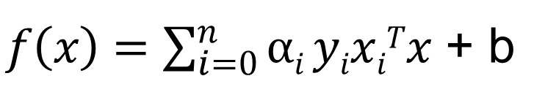
Machine Learning
“The science of getting computers to act without being explicitly programmed”
“Systems that can learn from data”
Data
Notes:
You may also be wondering, what is the difference between Data Science and Machine Learning? While Machine Learning is just one of the tasks in the Data Science process, today many people use Machine Learning and Data Science as interchangeable terms. Data Science refers to the umbrella of techniques needed to extract information and insights from data.
Machine learning is the study of algorithms that can learn from data. Rather than explicitly programming a computer to do something, a model is learned by providing a machine learning algorithm with examples to learn from. These examples are commonly referred to as training samples – also know as records, percepts, etc. The learning algorithm runs through these training examples to build up model coefficients.
The core objective of a learner (i.e., machine learning algorithm) is to generalize from its experience. By generalizable, we mean that the model will perform well on new, unseen data (e.g. records). If we overfit the model, then it may not work well on unseen data.
Machine learning itself is a subset of artificial intelligence. These algorithms have a wide range of computational complexity and varying degree of sophistication. For example, a “decision tree” is an example of a fairly simple algorithm, whereas a “deep learning neural network” is an example of a relatively complex and sophisticated algorithm. But regardless of the machine learning algorithm being used, a representative and sufficiently large training set is usually much more important than the actual machine learning algorithm being employed. The results of model building are very much predicated on data that you are feeding into the algorithm.

Slide 35
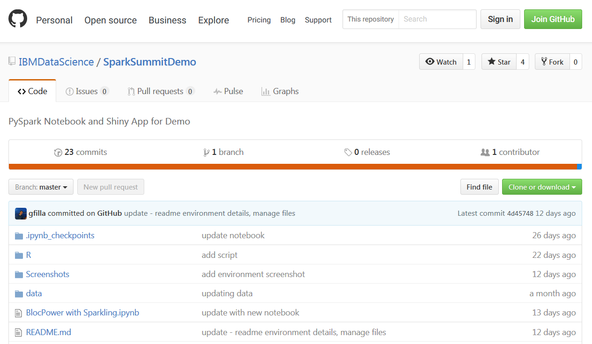
GitHub
Notes:
GitHub is a web-based Git repository hosting service. It offers all of the distributed revision control and source code management (SCM) functionality of Git as well as adding its own features. However, unlike Git (which is a command-line tool) GitHub provides a web-based graphical interface, along with access control and several collaboration features such as bug tracking, feature requests, task management, and wikis for every project.
To learn more about DSX and Git please check out this link: http://datascience.ibm.com/blog/github-integration-available-2/

Slide 36


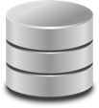
Motivation for Apache Spark
Traditional Approach: MapReduce jobs for complex jobs, interactive query, and online event-hub processing involves lots of (slow) disk I/O
HDFS Read
Iteration 1
HDFS Write
HDFS Read
Iteration 2
HDFS Write
CPU
Memory
CPU
Memory
Notes:
The single most defining attribute of Spark is its departure from slow I/O operations against spinning disks and hard drives. For traditional Hadoop/MapReduce, the slow performance of disks for frequent read and write operations is a significant, speed-hampering bottleneck. MapReduce jobs are very much dependent on high throughput of read & write requests; every time the system needs to perform a look-up or a commit to a spinning disk, there is some latency associated with that process. Over time, the cumulative effect of this bottleneck on performance can be significant; more importantly, it limits the types of use cases and data streams that traditional Hadoop distributions have been able to work with.
To illustrate this example, let's consider a complex MapReduce job that first performs an HDFS look-up from a spinning disk. Every job, task, or "iteration"– we can use each of these terms interchangeably –begins with a read from Hadoop (HDFS) storage. That data is transferred over the network and is swapped between the cluster's CPU(s) and memory (RAM) while the MapReduce product is calculated. At the conclusion of the job, this result MUST be written back to disk: an HDFS write operation is performed, incurring the I/O penalty we just described.
Note that every Iteration requires an HDFS read and HDFS write step. One thing you may have noticed is that we could look at one Iteration and see the same pattern of operations as may be required to "chain" together multiple Iterations.

Slide 37
Motivation for Apache Spark
Traditional Approach: MapReduce jobs for complex jobs, interactive query, and online event-hub processing involves lots of (slow) disk I/O
Solution: Keep data in-memory with a new distributed execution engine
HDFS Read
Iteration 1
HDFS Write
HDFS Read
Iteration 2
HDFS Write
CPU
Memory
CPU
Memory
HDFS Read
Iteration 1
Minimal Read/Write Disk Bottleneck
Iteration 2
Chain Job Output into New Job Input
CPU
Memory
CPU
Memory
Input
10–100x faster than network & disk
Notes:
Spark's solution is to remove storage on disks from the execution framework altogether. Ultimately, you may want to persist the final product of your computations to disk - or perhaps you won't require this at all. It's up to the determination of the programmer to decide what best fits their use case and whether they wish to persist the results for long-term storage. The key is that the execution & processing framework excludes these performance-hampering reads & writes from spinning disks altogether.
Once data has been loaded into Spark (for example, that initial load we see in the example above, just prior to Iteration 1), data is swapped between the CPU(s) and memory (RAM) as results are calculated. The output of that Iteration, however, does not need to be written back to disk – it can be stored temporarily (cached) in memory! And where Spark is truly unique is its ability to chain together multiple jobs (Iterations) without ever needing to write or read data from disk. The output of Iteration 1 can be piped directly as input into Iteration 2, and so on. This is incredibly powerful, performance, and opens the door to the type of use cases that Spark is able to address: interactive query, micro-batch streaming, and more are now possible, as a result of bypassing Hadoop's disk-dependency.

Slide 38
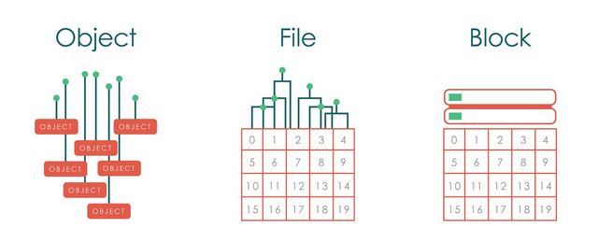
Object Storage
Object storage, also called object-based storage, is a generic term that describes an approach to addressing and manipulating discrete units of storage called objects.
Like files, objects contain data -- but unlike files, objects are not organized in a hierarchy. Every object exists at the same level in a flat address space called a storage pool and one object cannot be placed inside another object. Each object is assigned a unique identifier which allows a server or end user to retrieve the object without needing to know the physical location of the data.
Object storage is often compared to valet parking at an upscale restaurant. When a customer uses valet parking, he exchanges his car keys for a receipt. The customer does not know where his car will be parked or how many times an attendant might move the car while the customer is dining. In this analogy, a storage object's unique identifier represents the customer's receipt.
¹http://searchstorage.techtarget.com/definition/object-storage
Notes:
Object storage, also called object-based storage, is a generic term that describes an approach to addressing and manipulating discrete units of storage called objects.
Like files, objects contain data -- but unlike files, objects are not organized in a hierarchy. Every object exists at the same level in a flat address space called a storage pool and one object cannot be placed inside another object. Each object is assigned a unique identifier which allows a server or end user to retrieve the object without needing to know the physical location of the data.
Object storage is often compared to valet parking at an upscale restaurant. When a customer uses valet parking, he exchanges his car keys for a receipt. The customer does not know where his car will be parked or how many times an attendant might move the car while the customer is dining. In this analogy, a storage object's unique identifier represents the customer's receipt.

Slide 39
Object Storage
Object storage systems allow relatively inexpensive, scalable and self-healing retention of massive amounts of unstructured data. Object storage is used for diverse purposes such as storing photos on Facebook, songs on Spotify, or files in online collaboration services, such as Dropbox.
Object Storage provides an unstructured cloud data store to build and deliver cloud applications and services with lowered cost, reliability, and speed to market. Bluemix developers and users can access and store unstructured data content and can interactively compose and connect to applications and services. The Object Storage service also provides programmatic access via API, SDKs and a consumable UI for object management.
Cloud Storage - store all your files (images, documents, and more) in the cloud. Use metadata to quickly tag and search your objects. Easily compose and bind to your object files from your Bluemix application.
Easy Access - use drag and drop to quickly upload and manage your object store content or use industry adopted OpenStack Swift API and SDKs to access your object store programmatically.
Notes:
Object storage systems allow relatively inexpensive, scalable and self-healing retention of massive amounts of unstructured data. Object storage is used for diverse purposes such as storing photos on Facebook, songs on Spotify, or files in online collaboration services, such as Dropbox.
Object Storage provides an unstructured cloud data store to build and deliver cloud applications and services with lowered cost, reliability, and speed to market. Bluemix developers and users can access and store unstructured data content and can interactively compose and connect to applications and services. The Object Storage service also provides programmatic access via API, SDKs and a consumable UI for object management.
Cloud Storage - store all your files (images, documents, and more) in the cloud. Use metadata to quickly tag and search your objects. Easily compose and bind to your object files from your Bluemix application.
Easy Access - use drag and drop to quickly upload and manage your object store content or use industry adopted OpenStack Swift API and SDKs to access your object store programmatically.

Slide 40




DSX – Projects
Data Lake
Sandbox1
Sandbox2
Projects make collaboration easier
Projects allow different users and personas to share a set of assets
Projects enable you to collaborate and manage your notebooks, artifacts, etc.
Projects have three levels of rights -- viewers, editors, and admin
Assets
…...
#1
#2
#3
#4
Project Service
…...
Project 1
Project 2
Data Engineer
Developer
Data Scientist
Business Analyst
Notes:
Projects are a core component of our next generation platform, Watson Data Platform. Projects make collaboration easier. They allow different users and personas to share sets of assets while building their data products. For example, you can create a Project, add in your assets such as a notebook and files in object storage, and then add collaborators such as your co-workers. Your collaborators can have different permission rights too. Maybe you’ll make some of your collaborators Editors of the Project, others Viewers, and maybe a couple of people will have Admin rights.

